Slide 1

MGM’s College of Engineering & Technology
University of Mumbai
Department of Computer Engineering
Mini Project
On
Multimodal Transportation Optimization
TE-A
Presented by: Mansi Kamble, Divya Gupta, Swapnali Magdum, Rucha Junghare
Under Guidance of : Prof. Rajeshree Sonawale

Slide 2
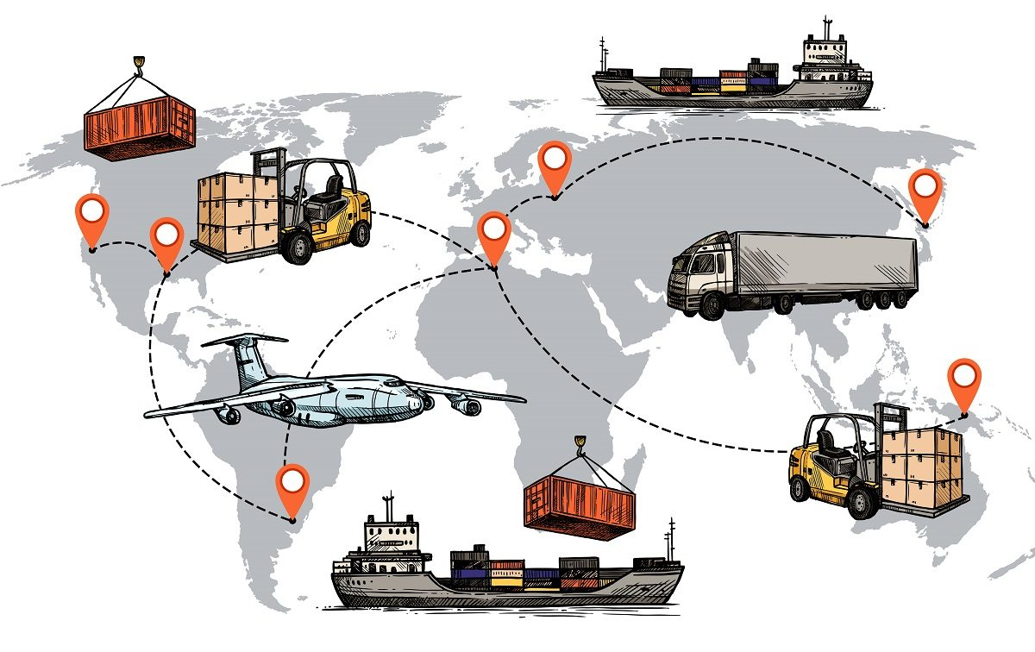
Introduction
The Transportation is back bone for export and import infrastructure for a country. The effort should be directed in such a way that international transportation becomes hassle free and rapid.
The great transport system is one of the inheritances enjoyed by this generation, which are Road, Rail, Air and Water. All of these developed independently of each other in large extent.
Each mode carries some distinct characteristics. No distinct mode has the Capability to meet all requirement from all shippers. Also a single mode is not able to handle all types of goods with equal efficiency. However, no amount of innovation can give the airplane advantage of railroads or no development in railroad will enable water carriers to leave their channels.
All these modes play vital role in a nation’s development. So it becomes imperative to utilize each mode in its best efficiency.

Slide 3
OVERVIEW
In delivery services, many different transportation tools such as trucks, airplanes and ships are available. Different choices of routes and transportation tools will lead to different costs.
To minimize cost, we should consider goods consolidation (Occasions when different goods share a journey together) , different transportation costs and delivery time constraints etc.
This project uses mathematical programming to model such situation and solves for overall cost minimization solution. The model construction offers options of two mathematical programming frameworks, DOcplex and CVXPY.

Slide 4
PROBLEM STATEMENT
In our case, there are 8 goods, 4 cities/countries (Shanghai, Wuxi, Singapore, Malaysia), 16 ports and 4 transportation tools. The 8 goods originate from different cities and have different destinations.
Each city/country has 4 ports, the airport, railway station, seaport and warehouse. There are in total 50 direct routes connecting different ports.
Each route has a specific transportation tool, transportation cost, transit time and weekly schedule. Warehouse in each city allows goods to be deposited for a period of time so as to fit certain transportation schedules or wait for other goods to be transported together. All goods might have different order dates and different delivery deadlines.
With all these criteria, how can we find out solution routes for all goods that minimize the overall cost?

Slide 5
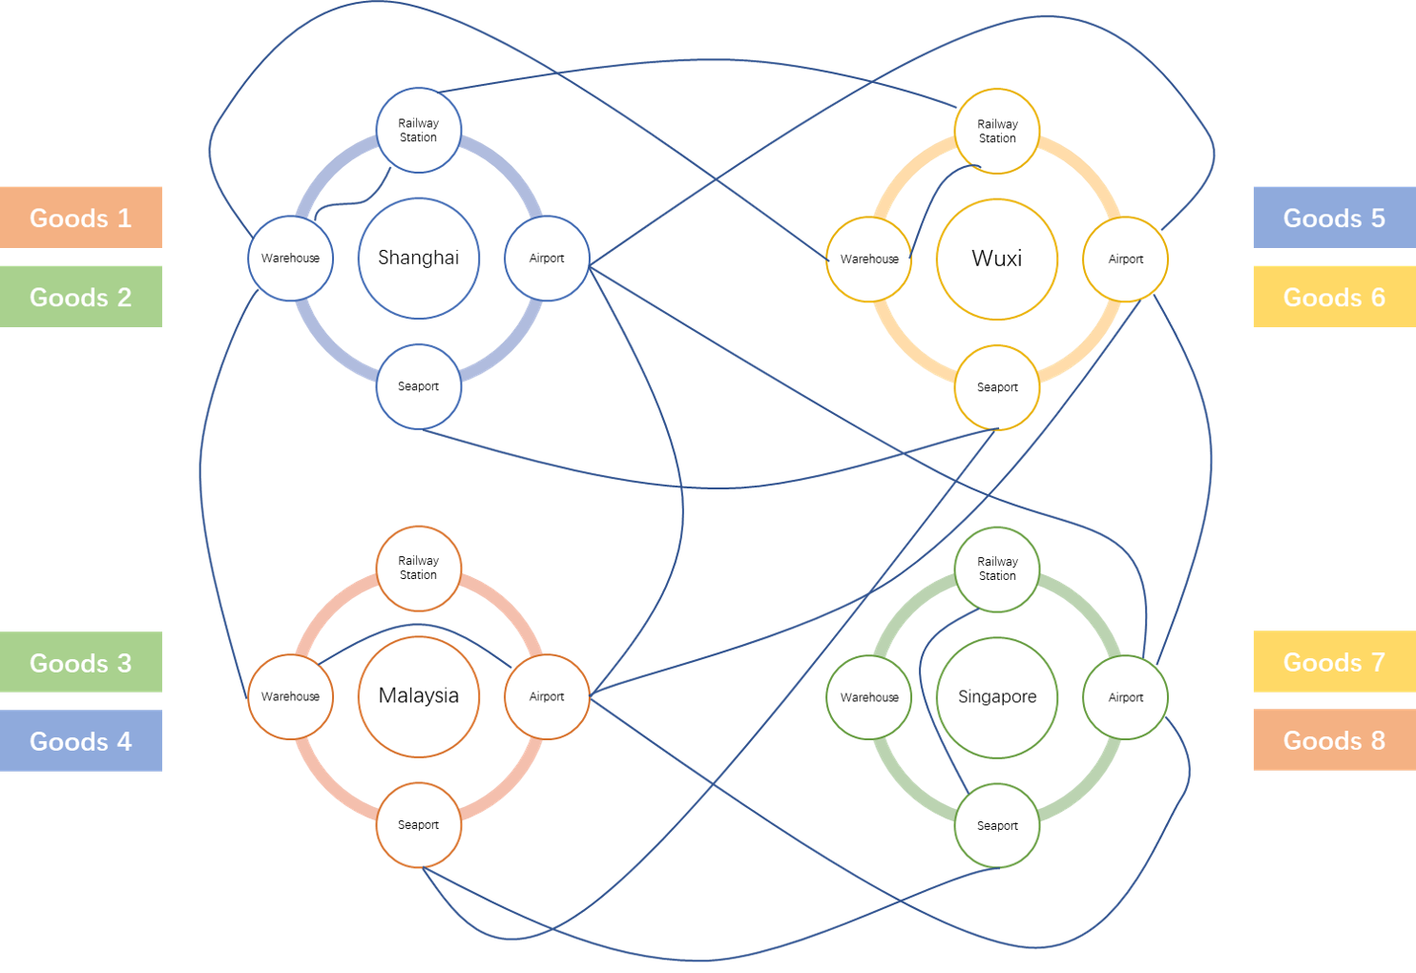

Slide 6
Assumption :
The delivery process is deterministic, no random effect will appear on delivery time and cost etc.
Goods can be transported in normal container, no special containers (refrigerated, thermostatic etc.) will be needed.
Container only constraints on the good's volume, and all goods are divisible in terms of volume. (No bin packing problem needed to be considered.)
The model only evaluates the major carriage routes. The first and last mile between end user and origin/destination shipping point are not considered. (From warehouse to warehouse.)
There is only one transportation tool available between each two ports. For instance, we can only directly go from one airport to the other airport in different cities by flight, while direct journey by ship or railway or truck is infeasible.
Overall cost is restricted to the most important 3 parts, transportation cost, warehouse cost and goods tariff.
The minimum unit for time is day in the model, and there is at most one transit in a route in one day.

Slide 7
Objective
The objective of the model is to minimize the overall cost, which includes 3 parts, transportation cost, warehouse cost and tax cost.
Firstly, the transportation cost includes container cost and route fixed cost. Container cost equals the number of containers used in each route times per container cost while route fixed cost equals the sum of fixed cost of all used routes.
Secondly, the warehouse cost equals all goods' sum of volume times days of storage times warehouse fee per cubic meter per day in each warehouse. Finally, the tax cost equals the sum of import tariff and transit duty of all goods. Mathematic formulation and Python implementation are attached below.

Slide 8
DIMENSIONS AND MATRIXING
In order to make the criteria logic clearer and the calculation more efficient, we use the concept of matrixing to build the necessary components in the model. In our case, there are totally 4 dimensions:
Start Port: i Indicating the start port of a direct transport route. The dimension length equals the total number of ports in the data.
End Port: j Indicating the end port of a direct transport route. The dimension length equals the total number of ports in the data.
Time: t Indicating the departure time of a direct transport. The dimension length equals the total number of days between the earliest order date and the latest delivery deadline date of all goods in the data.
Goods: k Indicating the goods to be transported. The dimension length equals the total number of goods in the data.

Slide 9
Convex optimization
Convex optimization is a subfield of mathematical optimization that studies the problem of minimizing convex functions over convex sets. Many classes of convex optimization problems admit polynomial-time algorithms,^{[1]} whereas mathematical optimization is in general NP-hard.

Slide 10
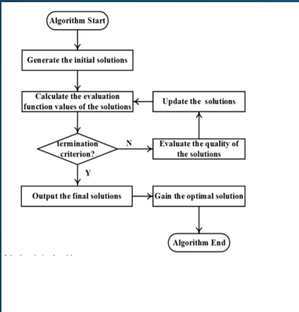
algorithm

Slide 11
Parameters
Per Container Cost: C A 3 dimensional parameter matrix, each dimension representing start port, end port and time. C_{i,j,t} in the matrix represents the overall transportation cost per container from port i to port j at time t. This overall cost includes handling cost, bunker/fuel cost, documentation cost, equipment cost and extra cost from model data.xlsx. For infeasible route, the cost element will be set to be big M (an extremely large number), making the choice infeasible.
Route Fixed Cost: FC A 3 dimensional parameter matrix, each dimension representing start port, end port and time. FC_{i,j,t} in the matrix represents the fixed transportation cost to travel from port i to port j at time t, regardless of goods number or volume. For infeasible route, the cost element will be set to be big M as well.
Warehouse Cost: wh A one dimension array with dimension start port. wh_{i} represents the warehouse cost per cubic meter per day at port i. Warehouse cost for ports with no warehouse function (like airport, railway station etc.) is set to be big M.
Transportation Time: T A 3 dimensional parameter matrix, each dimension representing start port, end port and time. T_{i,j,t} in the matrix represents the overall transportation time from port i to port j at time t. This overall time includes custom clearance time, handling time, transit time and extra time from model data.xlsx. For infeasible route, the time element will be set to be big M.

Slide 12
5. Tax Percentage: tax A one dimension array with dimension goods. tax_{k} represents the tax percentage for goods k imposed by its destination country. If the goods only goes through a domestic transit, the tax percentage for such goods will be set as 0.
6. Transit Duty: td A two dimensional matrix, each dimension representing start port and end port. td_{i,j} represents the transit duty (tax imposed on goods passing through a country) percentage for goods to go from port i to port j. If port i and port j belong to the same country, transit duty percentage is set to be 0. For simplicity purpose, transit duty is set to be equal among all goods. (can be extended easily)
7. Container Volume: ctnV A two dimensional matrix, each dimension representing start port and end port. ctnV_{i,j} represents the volume of container in the route from port i to port j.
8. Goods Volume: V A one dimension array with dimension goods. V_{k} represents the volume of goods k.
9. Goods Value: val A one dimension array with dimension goods. val_{k} represents the value of goods k.

Slide 13
10. Order Date: ord A one dimension array with dimension goods. ord_{k} represents the order date of goods k.
11. Deadline Date: ddl A one dimension array with dimension goods. ddl_{k} represents the deadline delivery date of goods k.
12. Origin Port: OP A one dimension array with dimension goods. OP_{k} represents the port where goods k starts from.
13. Destination Port: DP A one dimension array with dimension goods. DP_{k} represents the port where goods k ends up to be in.

Slide 14
ADVANTAGEs
Less time and effort
Cost reduction
Handling and delivery time efficiency
Increased transport security
One contract to keep track of
Easier freight tracking

Slide 15
Conclusion
Multimodal Transportation has become the key platform in facilitating exports and imports of any country. The researches carried out has applied simulation and mathematical techniques to improve the operations and efficiency at various nodes involved in Multimodal transportation. Containerization has played a crucial role in standardizing the operations involved. Analyzing the Multimodal Transportation value chain from and integrated perspective can remove great complications involved in this. In this approach the objectives might be conflicting with each other. The variable involved in this approach will arise from every aspect of management, but it deems a mandate to integrate the issues in Multimodal transportation as maximum is possible.

Slide 16
references
https://www.mdpi.com
https://opencivilengineeringjournal.com/VOLUME/9/PAGE/714/PDF/
https://www.sciencedirect.com/science/article/pii/S187770581600299X
https://www.researchgate.net/publication/282513409_Optimization_Models_and_Solution_Algorithms_for_Freight_Routing_Planning_Problem_in_the_Multi-Modal_Transportation_Networks_A_Review_of_the_State-of-the-Art
https://ieeexplore.ieee.org/document/8387103

